Slide 1
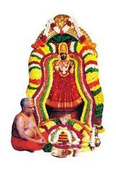


MINI PROJECT DESIGN OF SINGLE AXIS SOLAR TRACKER
OM SAKTHI
Adhiparasakthi engineering college
Melmaruvathur
Guide:
Mr.G.Sekar,
AP/CSE.
Done by:
Harish.N-420420104016
GowthamRaj.S-420420104014
Sedhumadhavan.V-420420104044

Slide 2
Introduction
The most-common applications for solar trackers are positioning photovoltaic (PV) panels (solar panels) So that they remain perpendicular to the Sun's rays and positioning space telescopes so that they can determine the Sun's direction.

Slide 3
Objective
To develop a tracking system that constantly tracking the sun during daytime.That generate maximize the solar panel power generation based on LDR.Monitor the movement of solar panel based on the intensity of light.

Slide 4
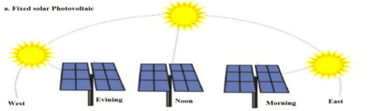
Problem statement
The problem here is the solar panel that is use only in fixed installation. Because of this problem, the power that can be generated is low.

Slide 5
Literature survey
EXISTING MODELS | PROPOSED BY | YEAR OF PUBLISHED | MERITS | DEMERITS
Horizontal Single Axis Solar Tracker Using Arduino Approach | Siti Amely Jumaat, Adam Afiq Azlan Tan, Mohd Noor Abdullah, Nur Hanis Radzi | 2018 | Cost effective and Low power consumption. | Limited processing power.
Efficient Single Axis Sun Tracker Design for Photovoltaic System | Hussain S. Akbar, Muayyad N. Fathallah , Ozlim O. Raoof | 2017 | Increased energy production by 40% compared to fixed pannel and Low cost. | Maintenance cost is high because of regular cleaning of moving part.

Slide 6
Literature survey
Single Axis Solar Tracker for Maximizing Power Production | Mst Jesmin Nahar , Md Rasel Sarkar , Moslem Uddin , Md Faruk Hossaine, Md Masud Rana | 2021 | Less maintenance cost. | Reduced durability because tracker have more moving parts then fixed pannel.
Optimized Single-Axis Schedule Solar Tracker in Different Weather Conditions | Nurzhigit Kuttybay, Ahmet Saymbetov, Saad Mekhilef, Madiyar Nurgaliyev, Didar Tukymbekov | 2020 | Power consumption is high. | Limited performance in extreme weather condition &more expensive.

Slide 7
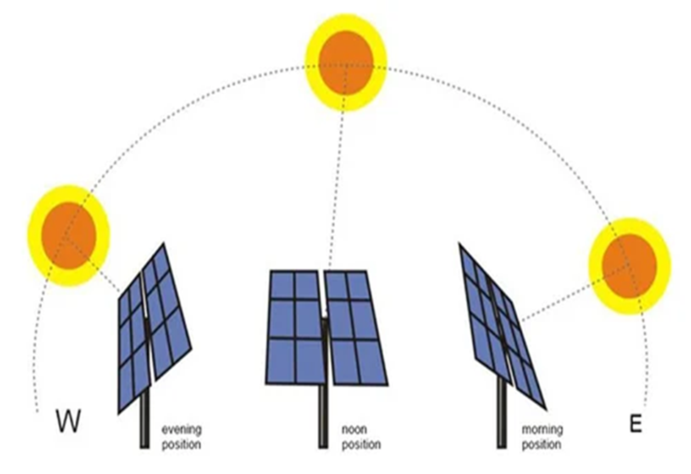
Problem Solution
We fixed the LDR sensor in solar panel left and right edges. it will automatically adjust the solar panel based on angle (or) direction of sun light . To consume more power generation.

Slide 8
Functional requirement
Tracking Capability: The solar tracker should be able to accurately track the movement of the sun along a single axis to maximize solar energy capture throughout the day.
Positioning Accuracy: The tracker should have precise positioning capabilities to ensure the solar panels are aligned correctly with the sun's position, optimizing energy generation.
Safety Features: The tracker should include safety mechanisms to protect the solar panels and the tracking system from extreme weather conditions such as high winds, storms, and snow loads.
Maintenance and Serviceability: The tracker should be designed for easy maintenance and serviceability, allowing for quick and efficient repairs or component replacements if required.

Slide 9
Non Functional requirement
Reliability: The tracker should operate reliably over extended periods, minimizing downtime and ensuring consistent solar energy generation.
Energy Efficiency: The tracker should consume minimal power during its operation to avoid energy wastage and optimize overall system efficiency.
Tracking Speed: The tracker should respond quickly to changes in the sun's position to maintain accurate tracking, reducing the time lag between movements and maximizing energy capture.
Cost-effectiveness: The tracker should be cost-effective in terms of initial investment, installation, and maintenance, providing a reasonable return on investment for solar energy generation.

Slide 10
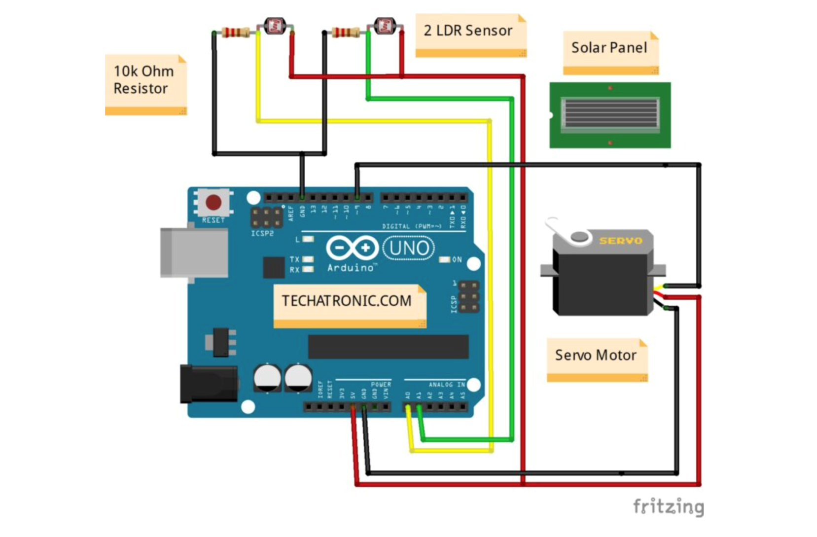
Architecture diagram

Slide 11
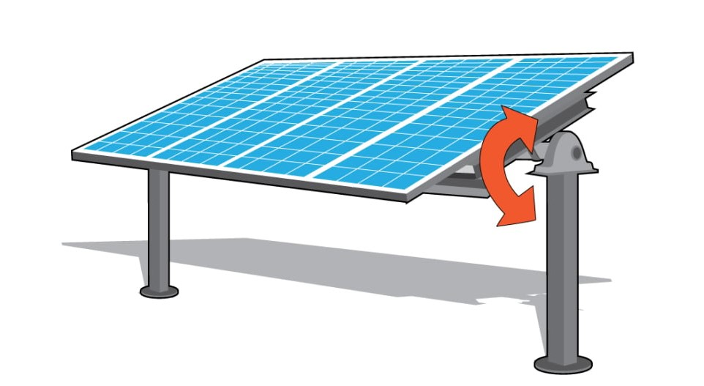
Modules Description
1. Building a Rotating fixture
single axis solar tracker has servo motor so it can rotate based on the direction of light.

Slide 12
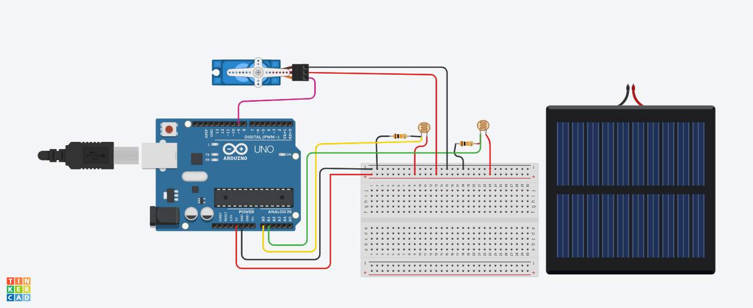
2.Connection Diagram

Slide 13
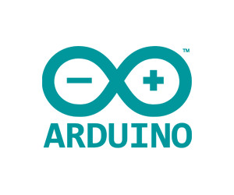
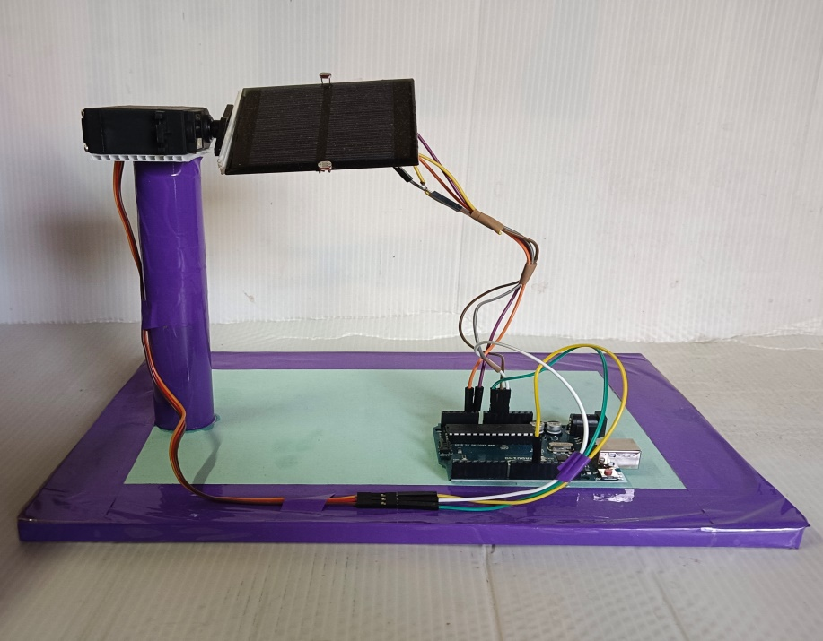
3.Software & Code
Arduino software

Slide 14
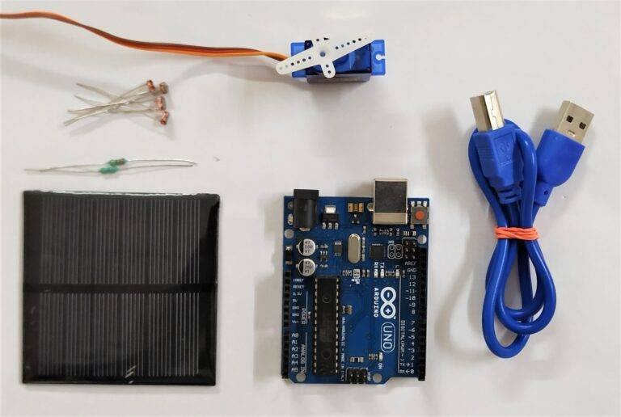
Components required

Slide 15

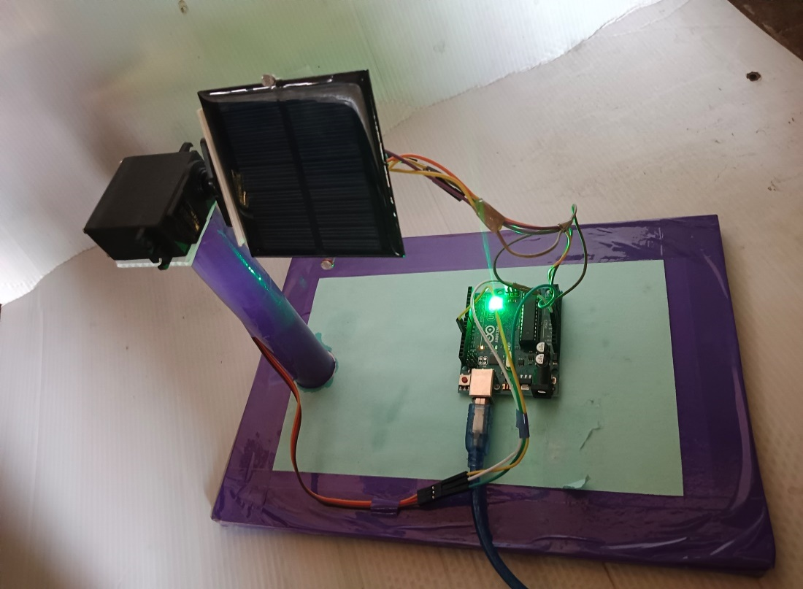
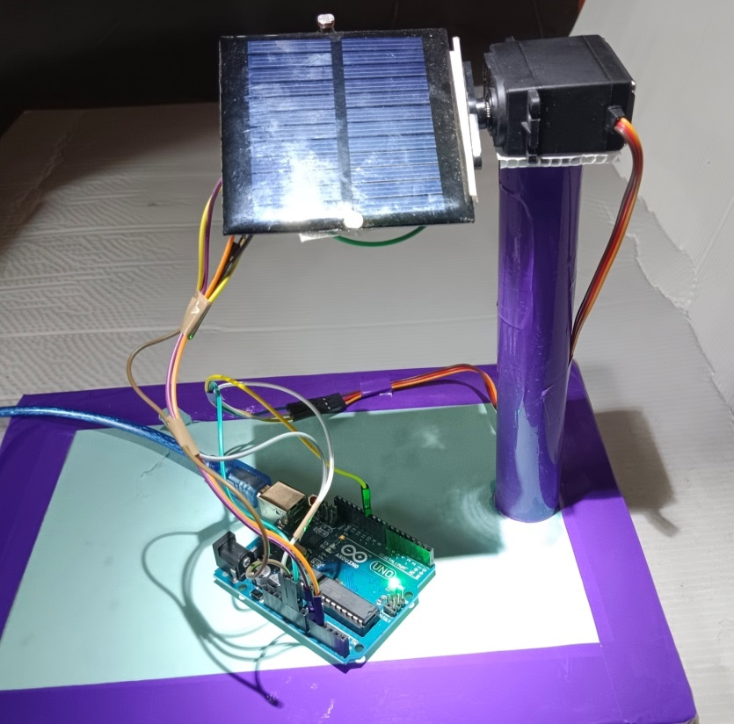
Result snapshot
INTIAL STATE
INPUT
OUTPUT

Slide 16
Applications
Utility-Scale Solar Projects
Commercial and Industrial Rooftop Systems
Off-Grid and Remote Applications
Residential Installations

Slide 17
Conclusion
An Arduino based single axis solar tracking system was designed and constructed in the current work.servo motor had enough torque to drive the panel.

Slide 18
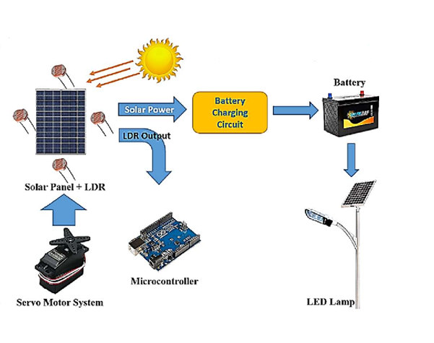
Future Work

Slide 19
References
A. Sharma, A. Srivastava, and N. Arora, "Design and Performance Evaluation of a Single-Axis Solar Tracker for Maximum Energy Yield" pp. 531-548, 2017.
M. S. Ahmed, M. R. Karim, and M. H. Ali, " "Design and Development of Low-Cost Single Axis Solar Tracking System"," International Conference on Electrical Engineering and Information & Communication Technology (ICEEICT), pp. 1-6, 2017.
K. Chinh, T. A. Nguyen, and H. T. Duong, " "Development and Analysis of a Low-Cost Single-Axis Solar Tracking System for Concentrated Photovoltaic Applications", pp. 1-6, 2016.
R. K. Raut, A. B. Kadam, and K. K. Kathane, " "Performance Analysis of a Single-Axis Sun Tracking System for Solar Panels, " International Conference on Electrical, Electronics, and Optimization Techniques (ICEEOT), pp. 2510-2515, 2016.

Slide 20
THANK YOU

